Slide 1

Egyptian Russian University
Faculty of Artificial Intelligence
Algorithms
ABA Sorting System ^_^
Aya Reda Mohamed El-nagar 225260
Bassant Hassan Salah El-shibly 225265
Aya Mohamed Anwer Omar 225237
–DR.Mohamed Behiry
–Eng.Mariam Mahmoud
Egyptian Russian University | 2024

Slide 2
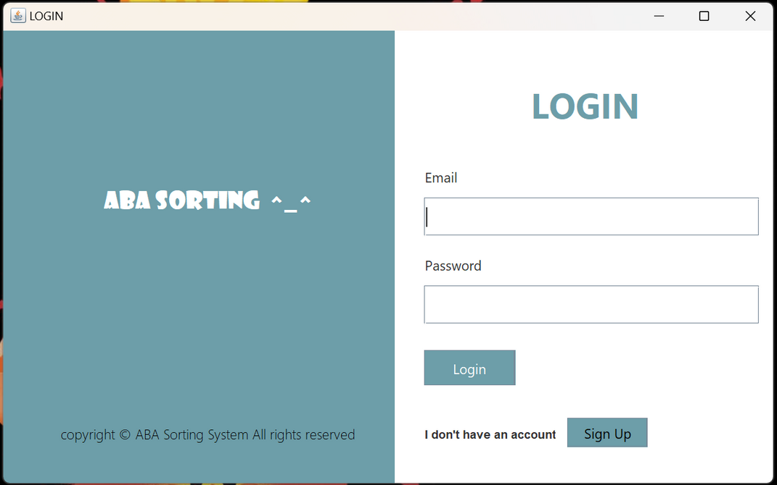
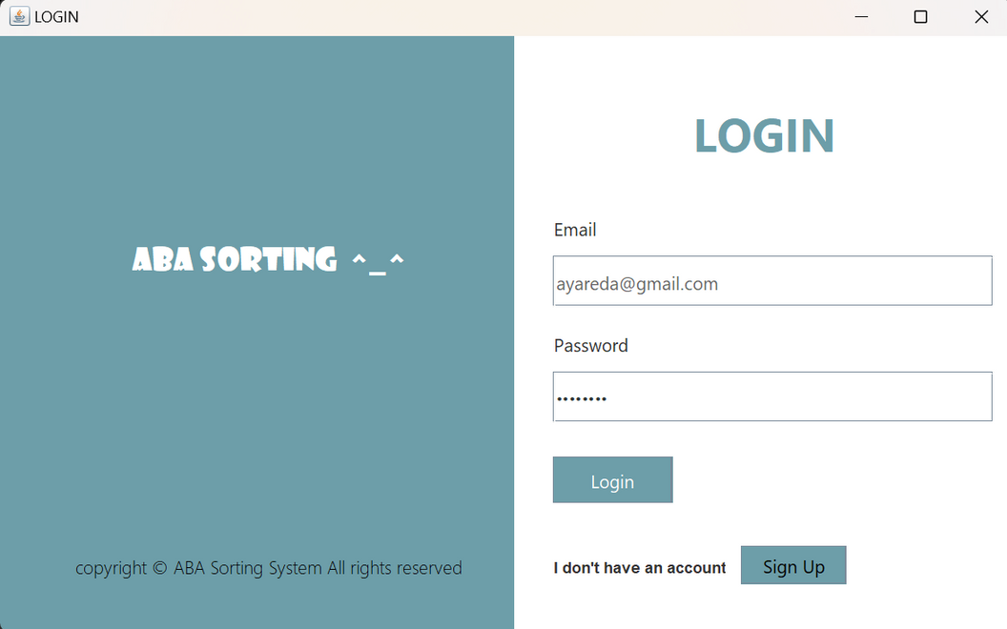
LOGIN PAGE :
THE LOGIN CLASS REPRESENTS A GRAPHICAL USER INTERFACE (GUI) FOR A LOGIN SCREEN IN A JAVA SWING APPLICATION. IT ALLOWS USERS TO ENTER THEIR EMAIL AND PASSWORD, THEN CLICK A "LOGIN" BUTTON TO ATTEMPT LOGIN. IF THE CREDENTIALS MATCH A PREDEFINED SET (IN THIS CASE, "AYAREDA@GMAIL.COM" AND "12345678"), IT OPENS THE MAIN APPLICATION WINDOW. OTHERWISE, IT DISPLAYS AN ERROR MESSAGE. ADDITIONALLY, THERE'S A "SIGN UP" BUTTON THAT OPENS A SIGNUP WINDOW FOR NEW USERS. THE CLASS UTILIZES EVENT HANDLING TO RESPOND TO USER ACTIONS SUCH AS BUTTON CLICKS.

Slide 3
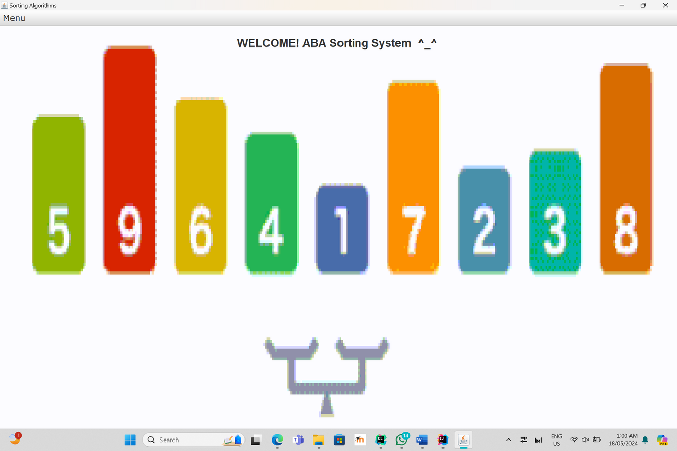
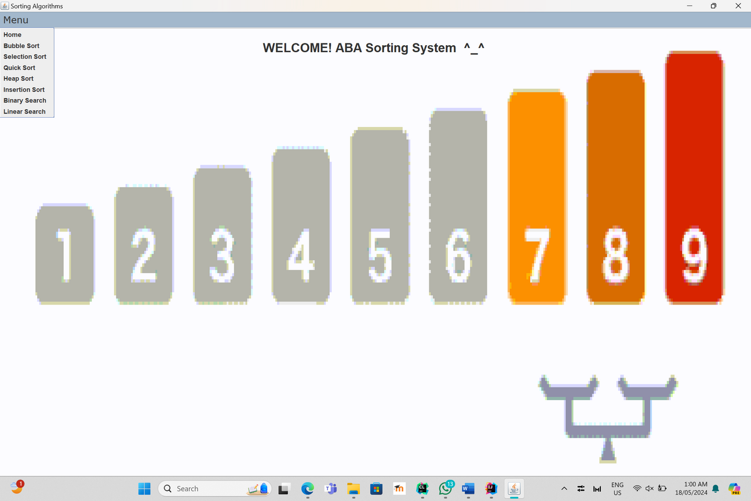
HOME PAGE:
This main page has a drop-down list at the word “Menu” from which we can choose the type of sort or search that we need to make.

Slide 4
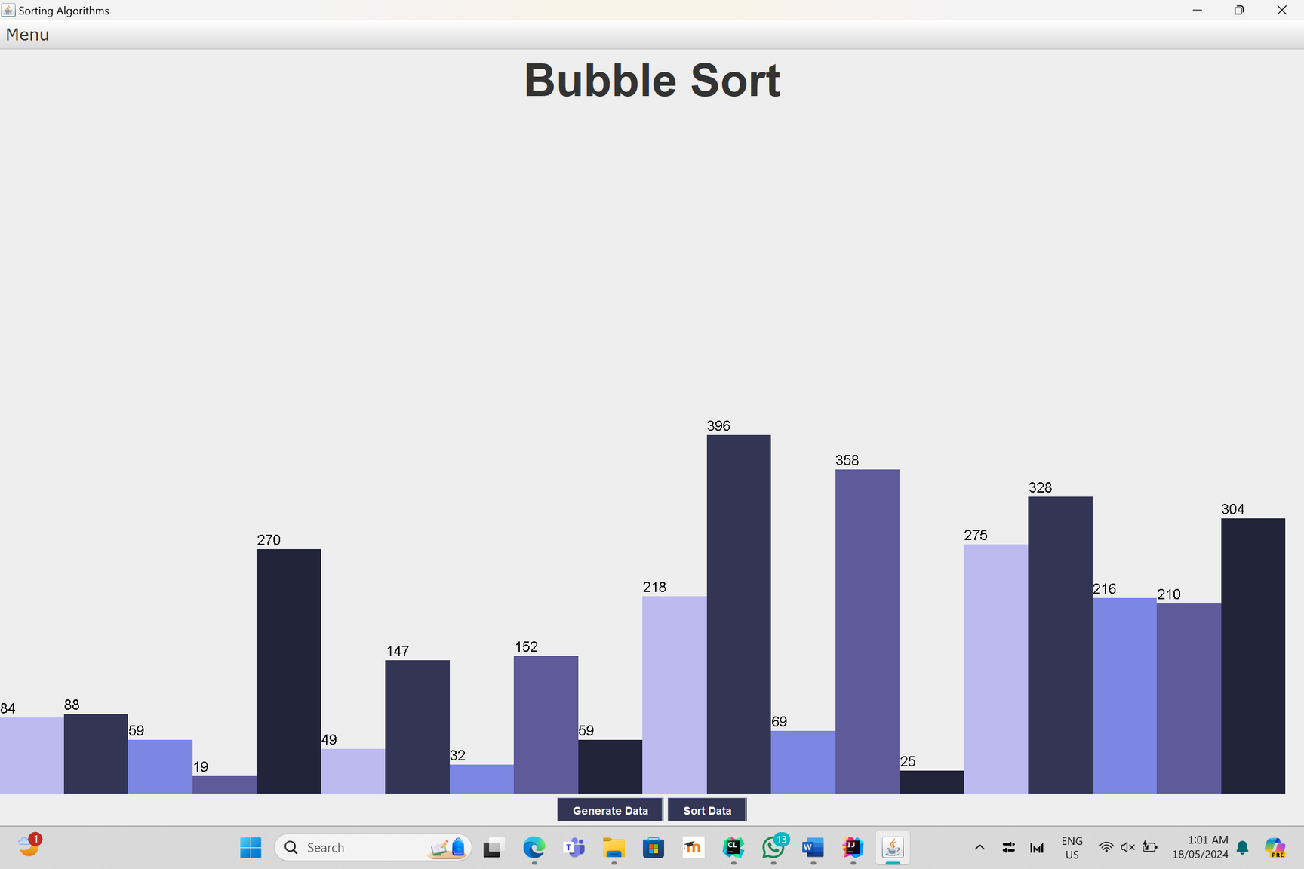
BUBBLE SORT:
Random values ​​can be changed by clicking on the generate data button, and when clicking on the sort data button, the elements are arranged in a visualization manner

Slide 5
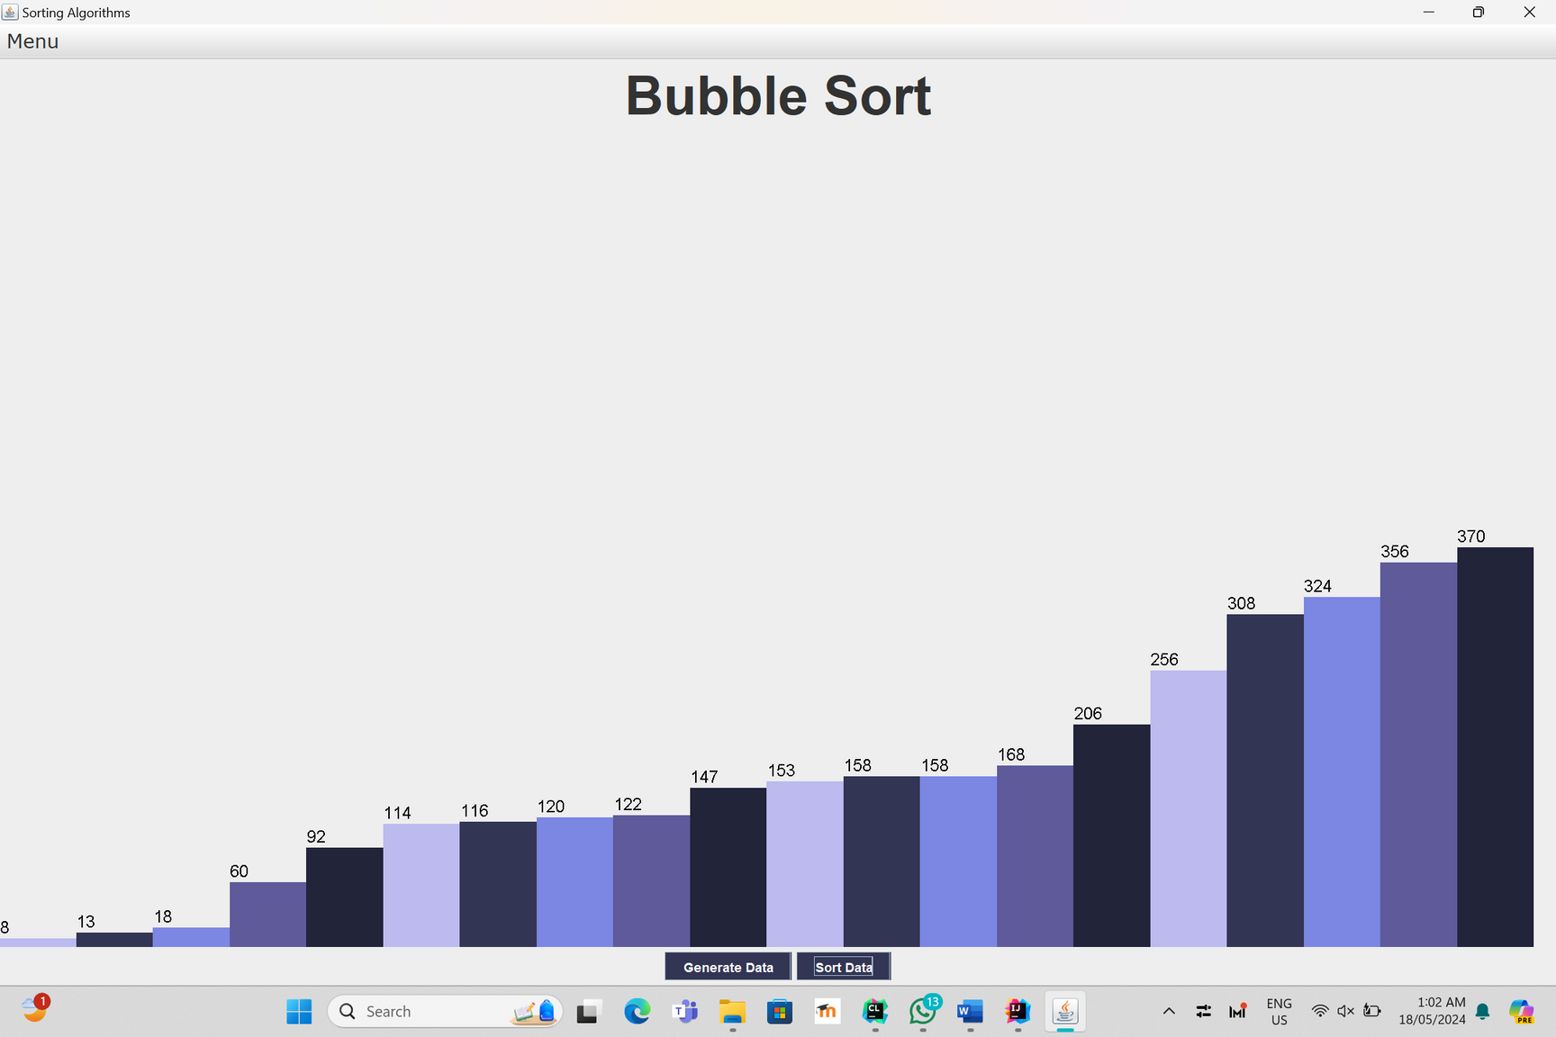
Items after sorting

Slide 6
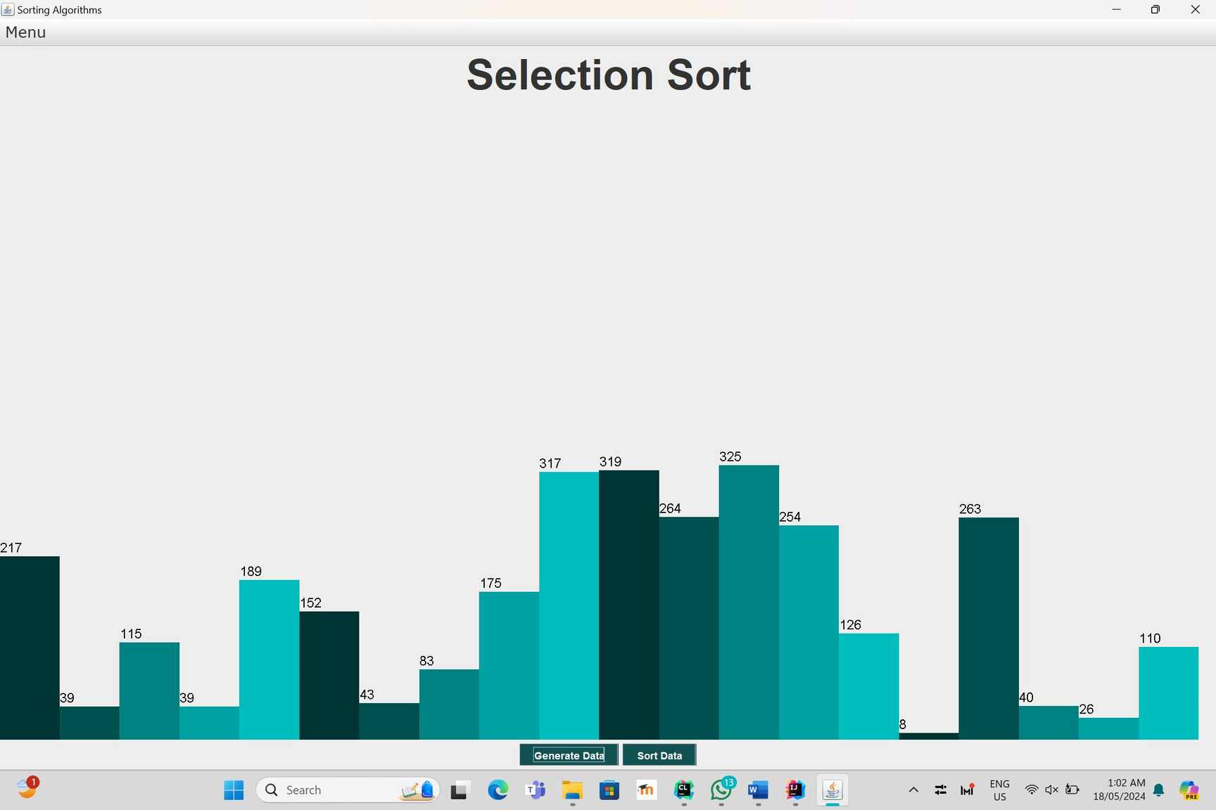
SELECTION SORT:
Random values ​​can be changed by clicking on the generate data button, and when clicking on the sort data button, the elements are arranged in a visualization manner

Slide 7
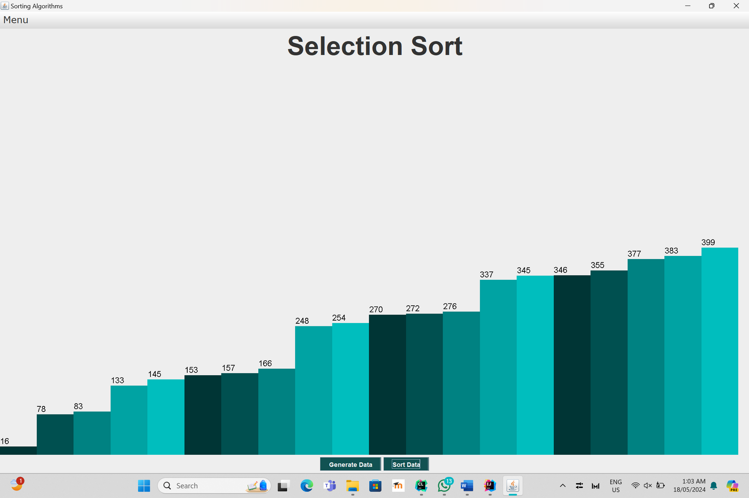
Items after sorting

Slide 8
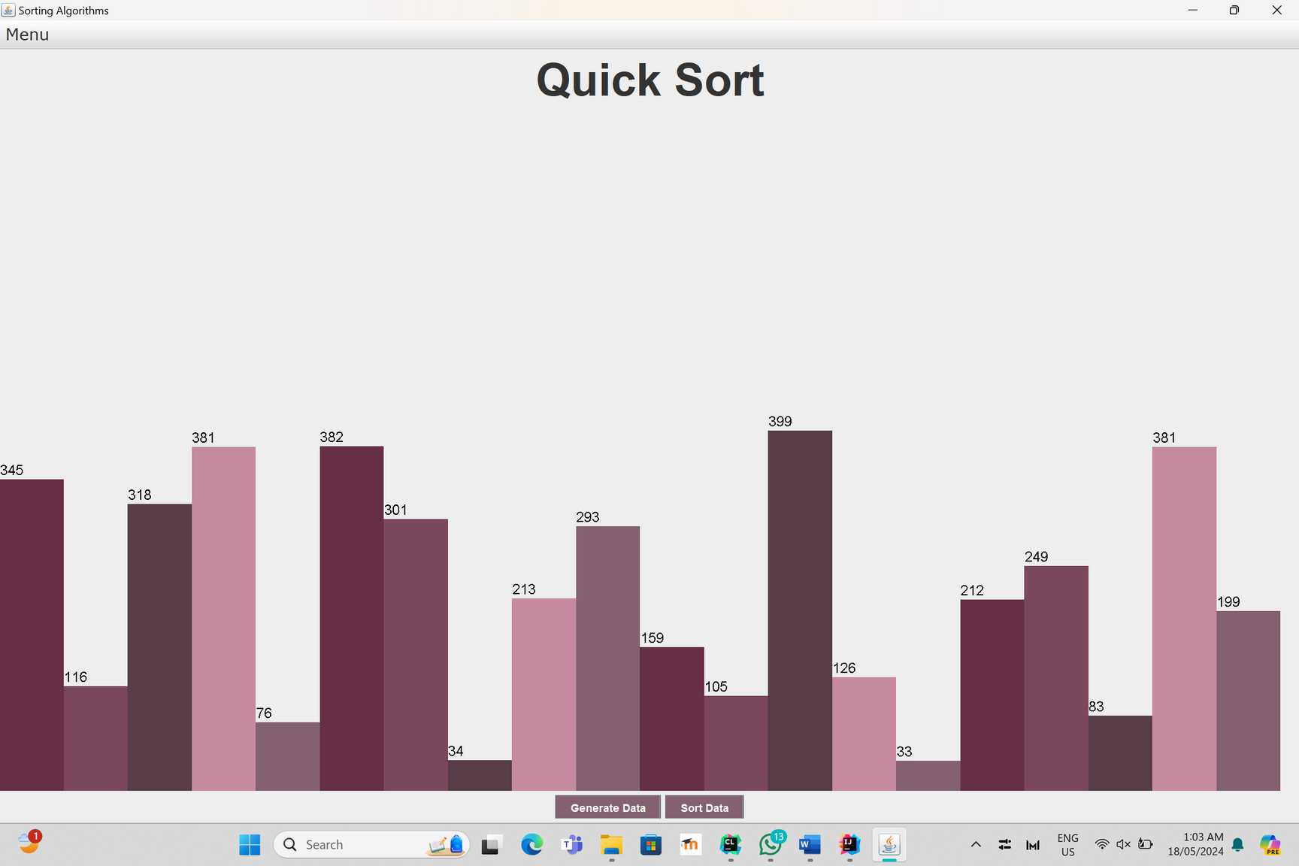
QUICk SORT:
Random values ​​can be changed by clicking on the generate data button, and when clicking on the sort data button, the elements are arranged in a visualization manner

Slide 9
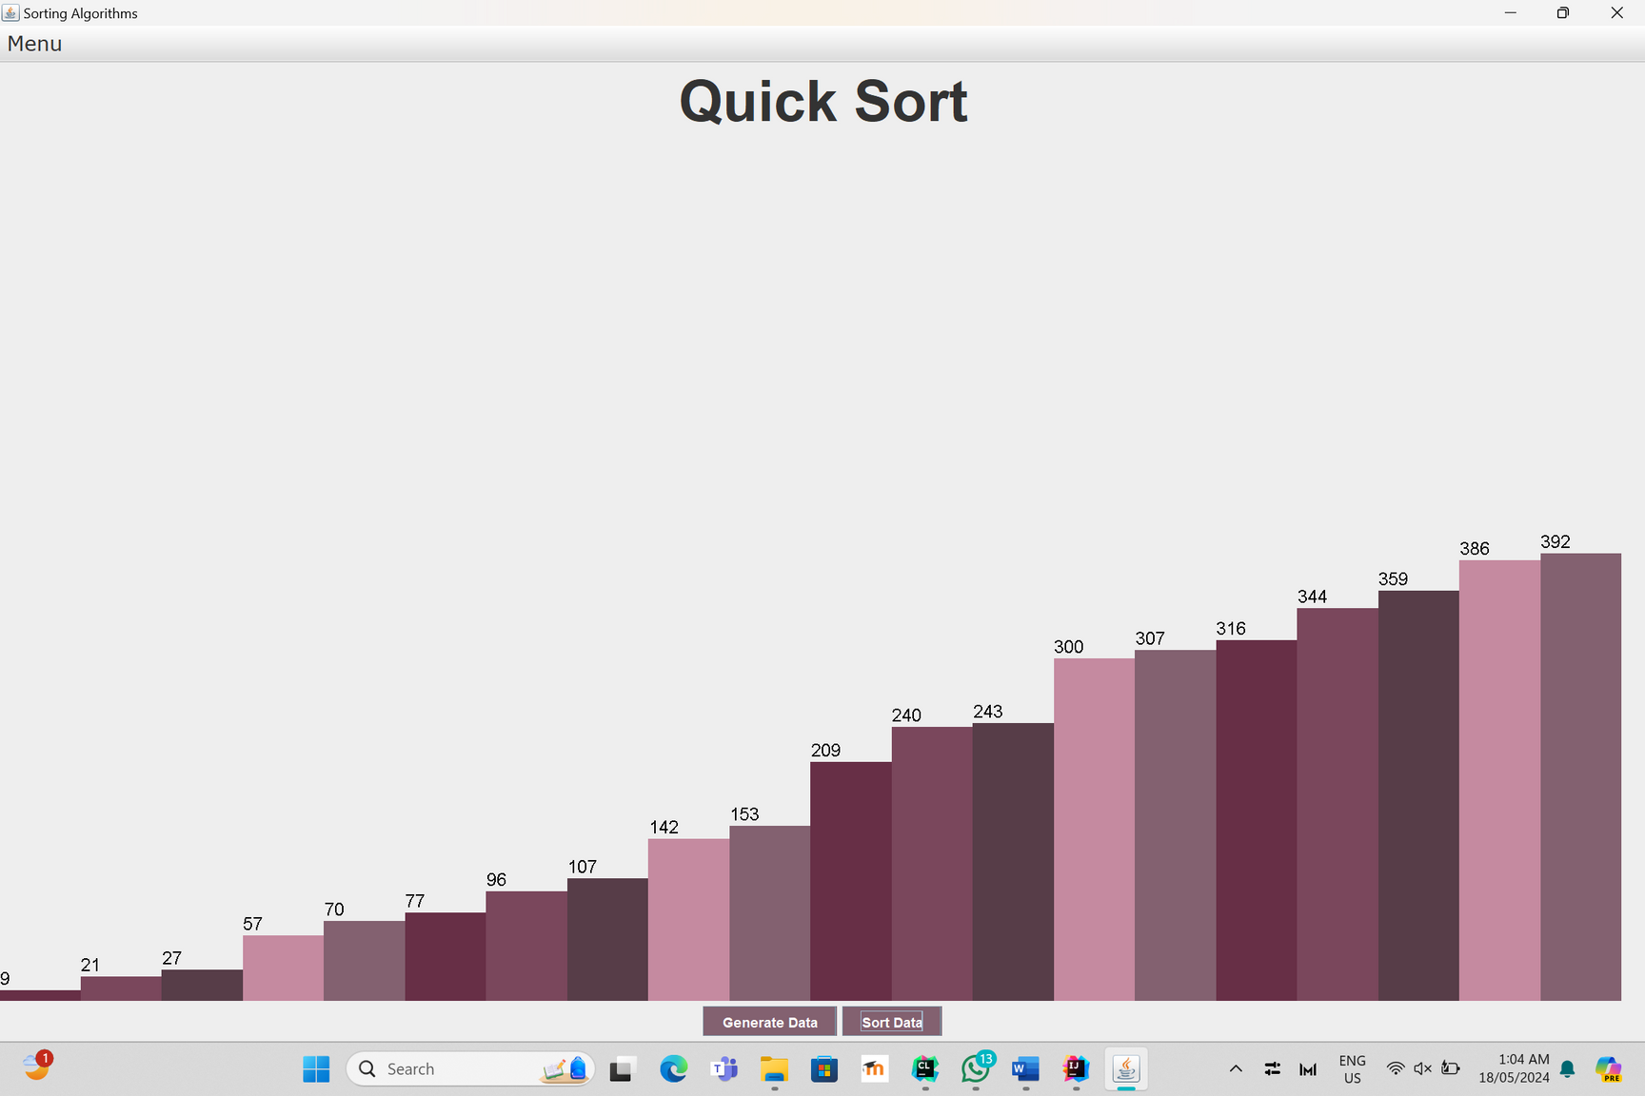
Items after sorting

Slide 10
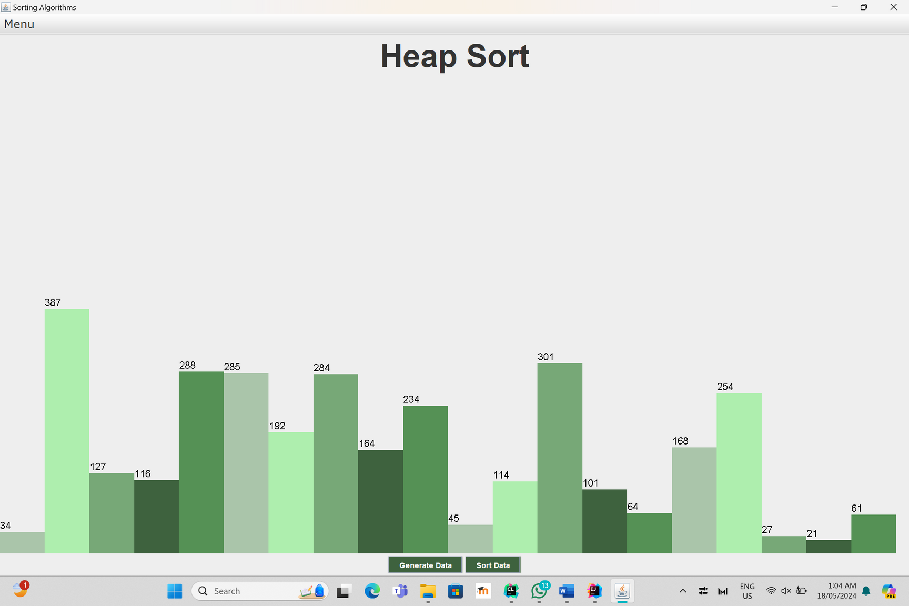
HEAP SORT:
Random values ​​can be changed by clicking on the generate data button, and when clicking on the sort data button, the elements are arranged in a visualization manner

Slide 11
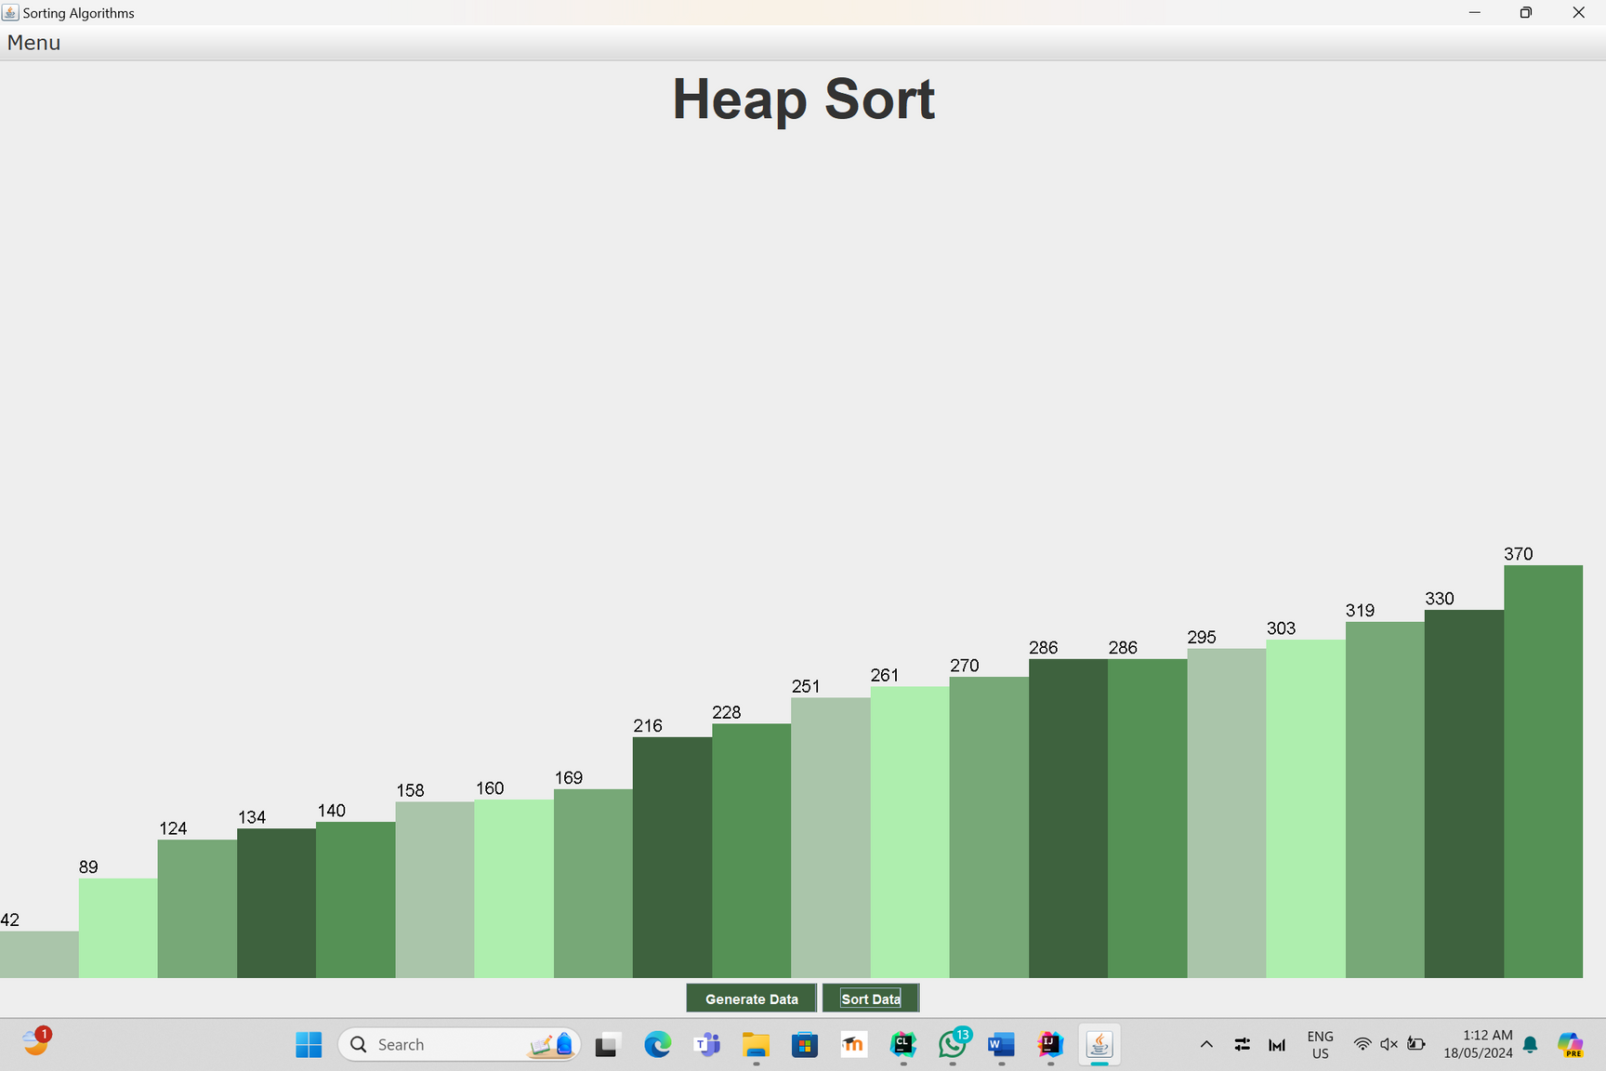
Items after sorting

Slide 12
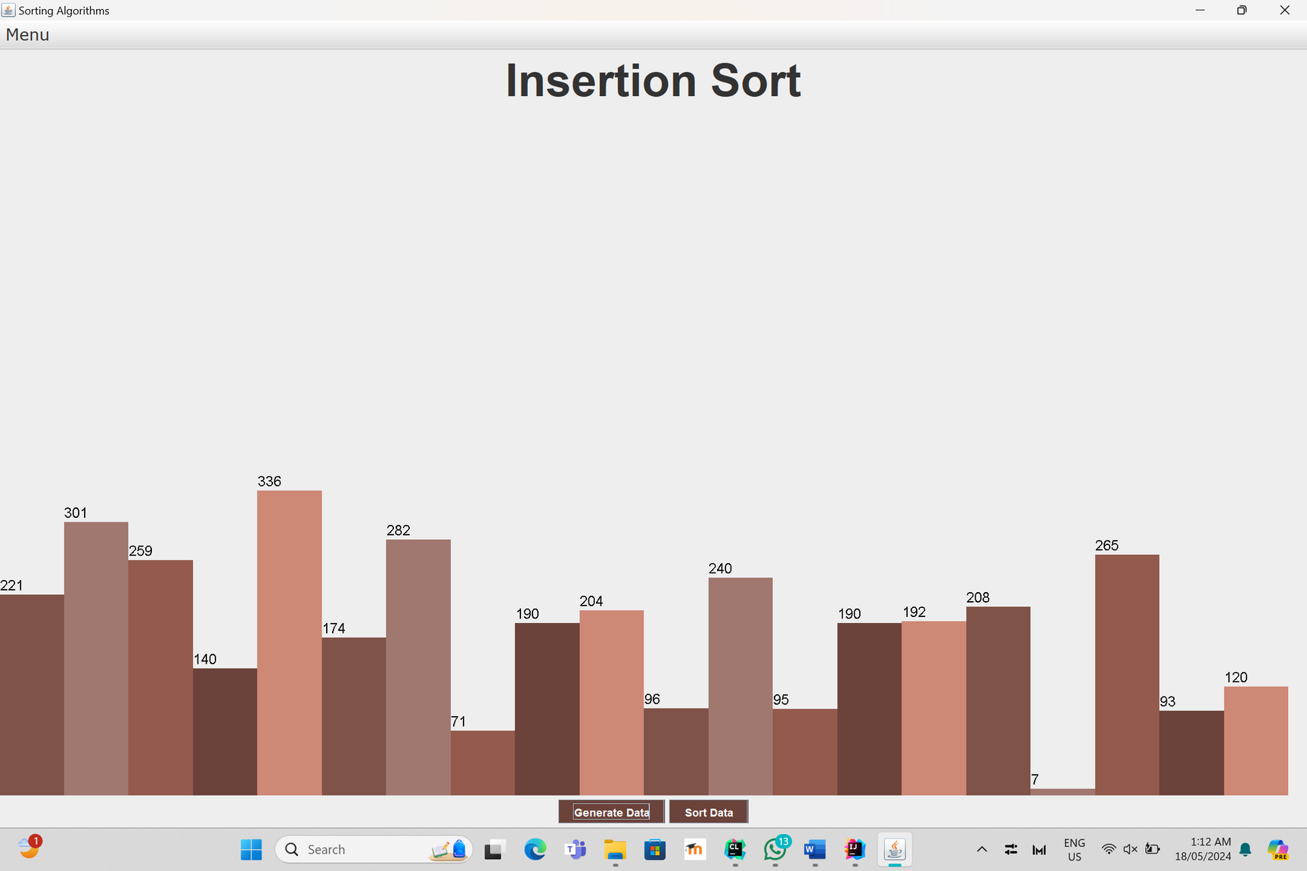
INSERTION SORT:
Random values ​​can be changed by clicking on the generate data button, and when clicking on the sort data button, the elements are arranged in a visualization manner

Slide 13
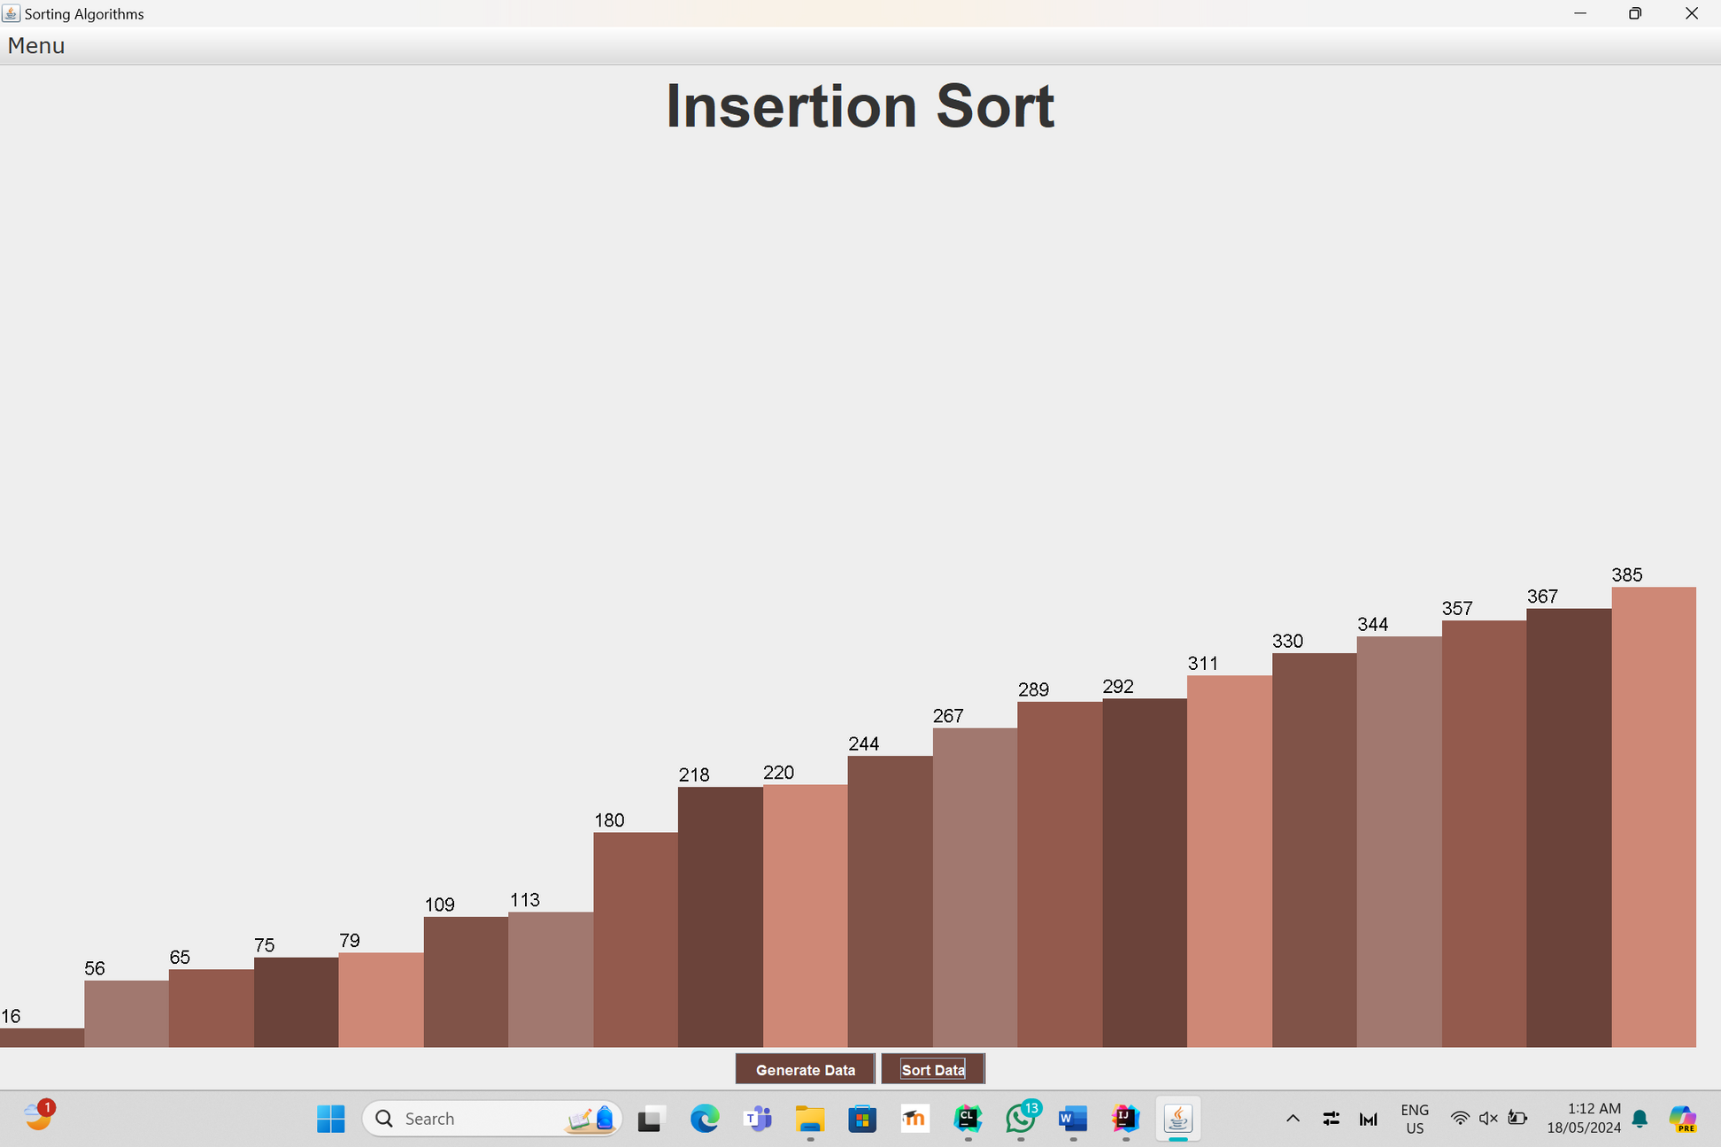
Items after sorting

Slide 14
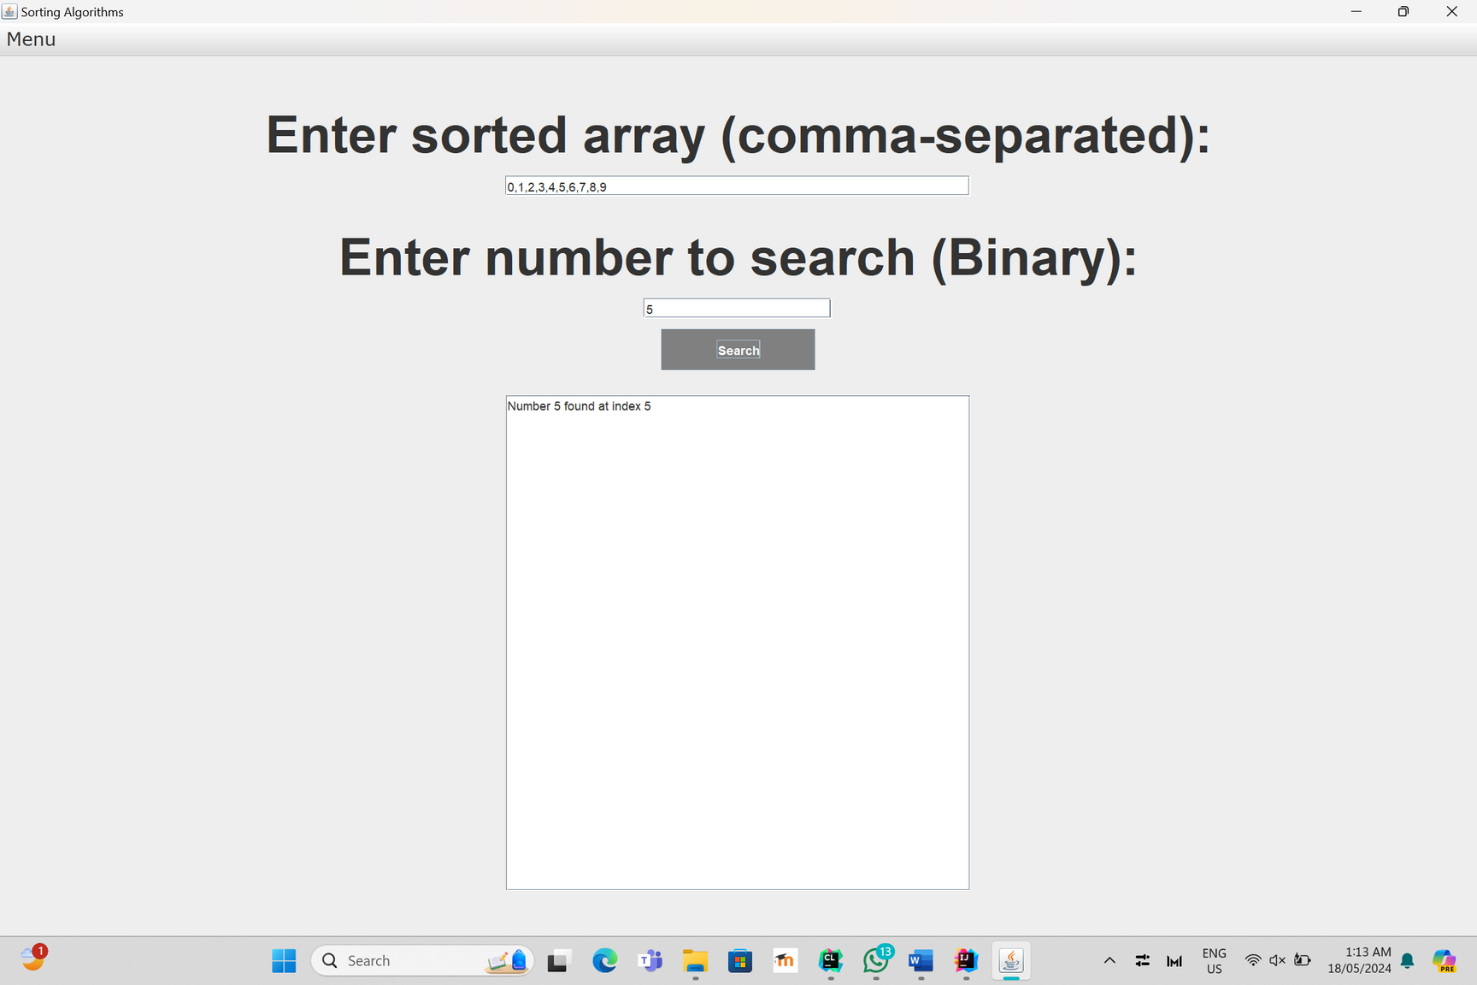
BINARY SEARCH:
Search for an existing element in the array after entering it in order in the cell at the top using the binary search method.

Slide 15
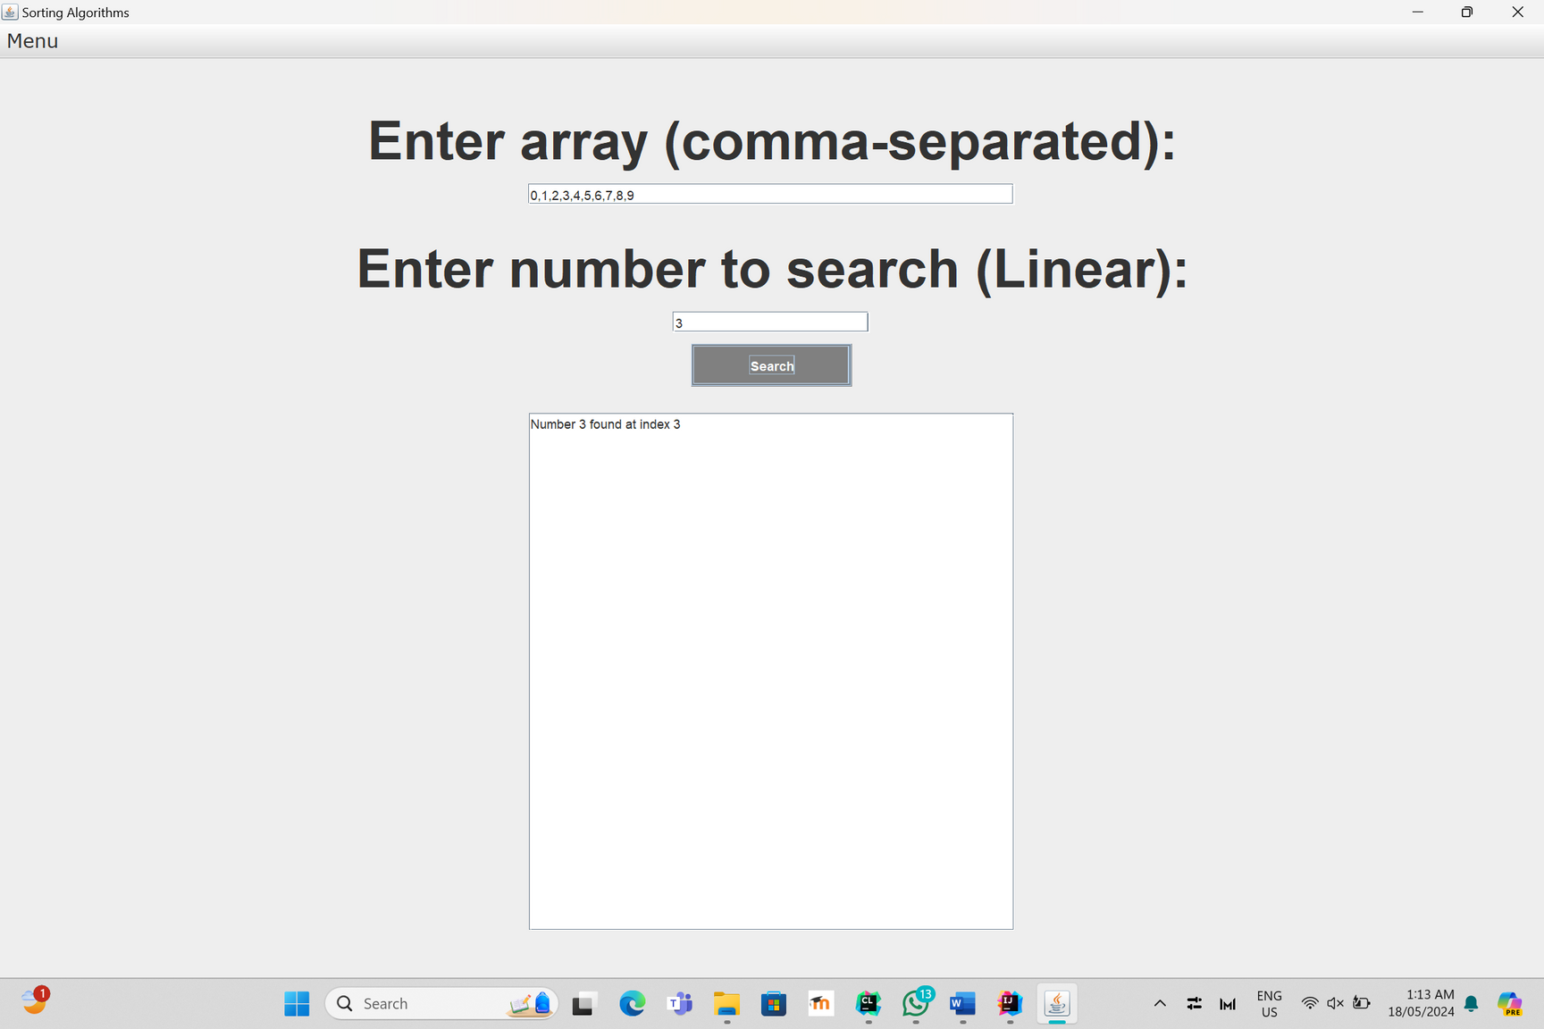
LINEAR SEARCH:
Search for an existing element in the array after entering it in order in the cell at the top using the linear search method.

Slide 16


Thank You

